Slide 1


RDF-based Object Type Libraries in construction project settings
ELIANA PAPOUTSOGLOU | JAN VOSKUIL
LBD, 5 April 2022

Slide 2

WHO WE ARE
Founded in 2012 as a Dutch consultancy specializing in knowledge engineering
Practical application of knowledge graphs
Reseller and implementation partner TopQuadrant's TopBraid suite for local customers
1

Slide 3


Meet the speakers
Eliana Papoutsoglou
Linked data consultant
Taxonic
Jan Voskuil
Ontologist | CEO
Taxonic
2
Notes:
Kristi:
Jack will say just a few words at a fairly high level about what EDG can do for you and what it offers governance initiatives, and then Jesse will show you EDG in action.
We will pause for a quick poll and have time at the end for a few questions and answers.
Thank you, Kristi. Let’s move right into today’s program about applied data governance with TopBraid EDG

Slide 4
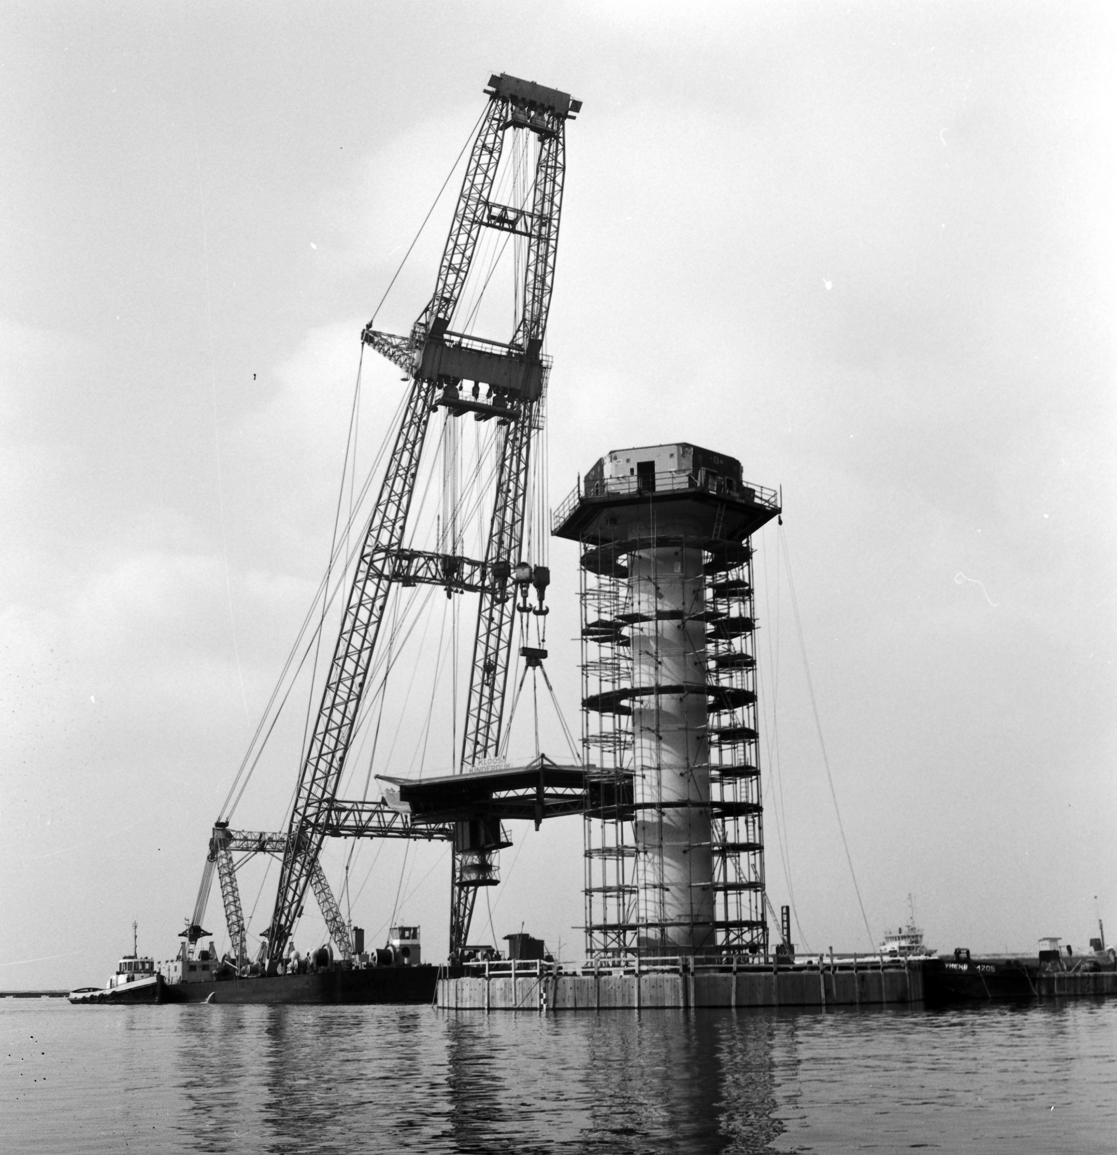
Agenda
1
Introduction
Rethinking asset information management
2
Demo
Seamless information exchange in construction projects
3
Evolving usage
Innovative usage scenarios
3

Slide 5

Datafication
FROM DOCUMENTS TO DATA
Documents still rule
Large infra projects use up to 10M documents
Manual processes
Computers offer tremendous potential
Move towards data
Computers understand data, not text
4
Notes:
Kristi:
Jack will say just a few words at a fairly high level about what EDG can do for you and what it offers governance initiatives, and then Jesse will show you EDG in action.
We will pause for a quick poll and have time at the end for a few questions and answers.
Thank you, Kristi. Let’s move right into today’s program about applied data governance with TopBraid EDG

Slide 6
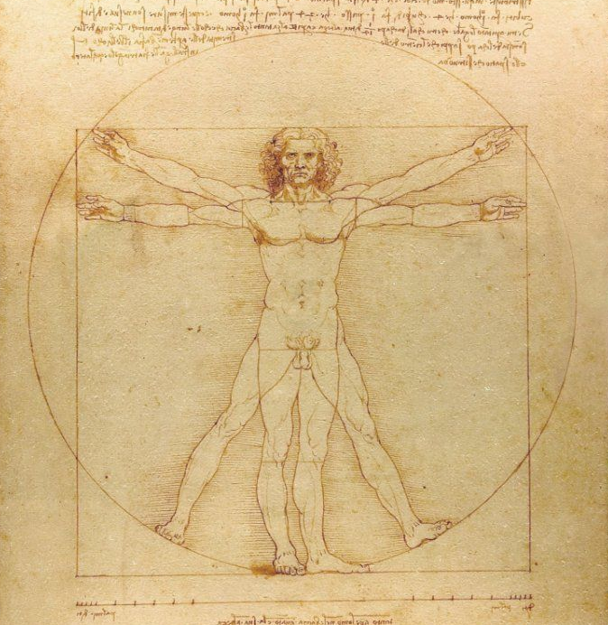
Datafication
EASIER SAID THAN DONE
Black hole
Data without data model are unusable
Data models hard-coded
Data models cannot be exchanged
Knowledge graphs
Knowledge graphs represent data and data model

Slide 7
RDF
Exchanging data models
NAMING
DEFINITION
DESCRIPTION
RULES
CONSTRAINTS
Importance of data models
Data models provide semantics so that computers “understand” data
SEMANTIC
MODEL
Semantic triangle
Class hierarchy, definition, constraints
CLASSES
INHERITANCE

Slide 8
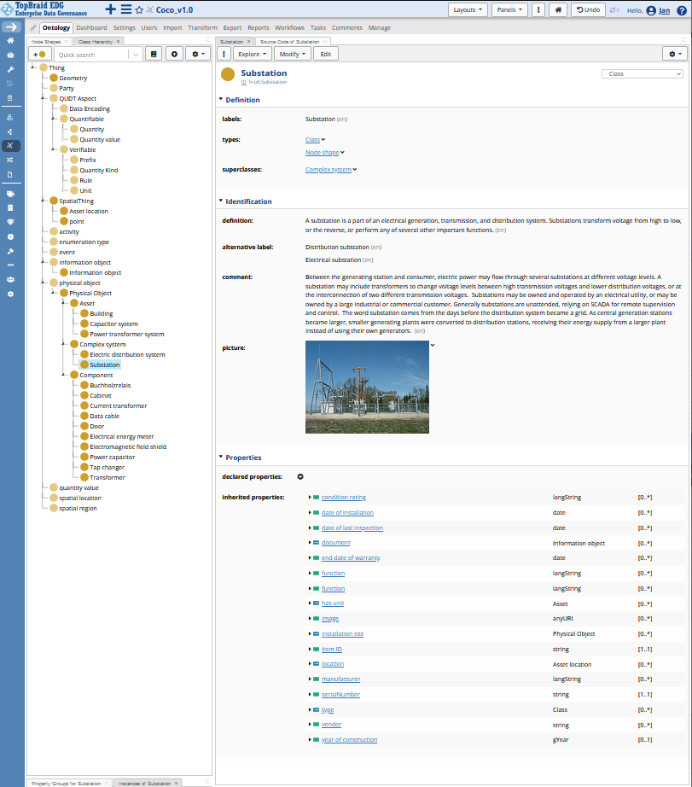
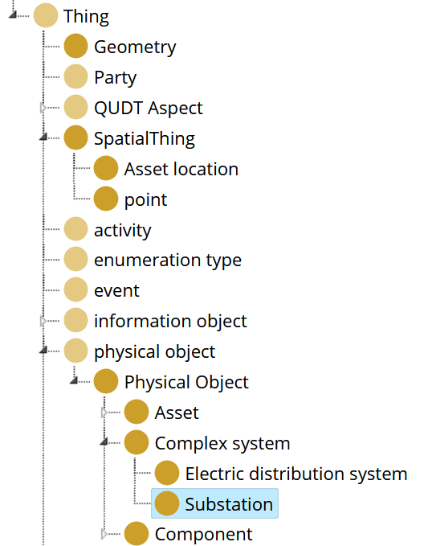
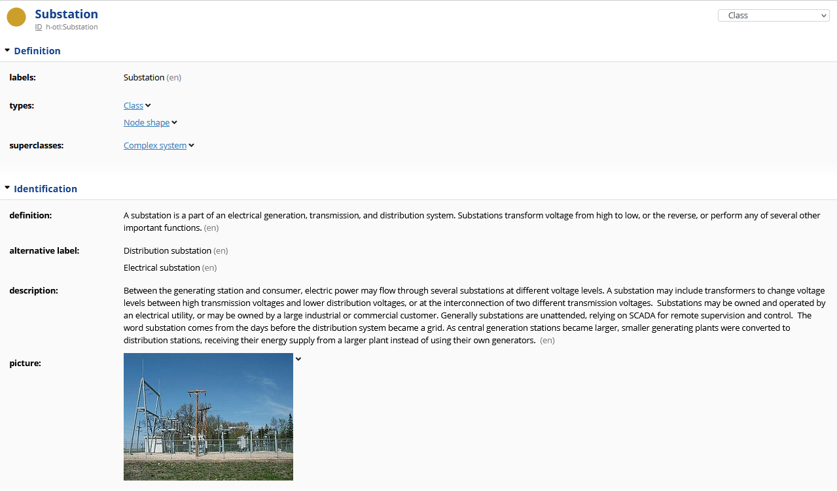
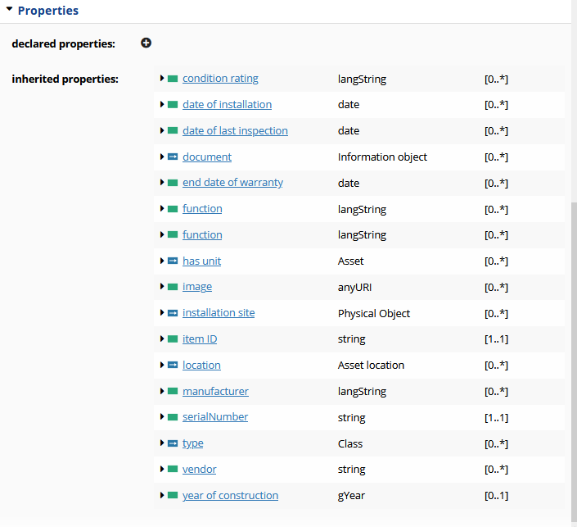
NAMING
DEFINITION
DESCRIPTION
CLASSES
INHERITANCE
RULES
CONSTRAINTS
8

Slide 9
NAMING
DEFINITION
DESCRIPTION
CLASSES
INHERITANCE
RULES
CONSTRAINTS
9

Slide 10
NAMING
DEFINITION
DESCRIPTION
CLASSES
INHERITANCE
RULES
CONSTRAINTS
10

Slide 11
NAMING
DEFINITION
DESCRIPTION
RULES
CONSTRAINTS
CLASSES
INHERITANCE

Slide 12
Contractor
A
USING GRAPHS
The principal’s perspective
project
Contractor
B
Principal
project
Exchangeable models
Object Type Library
Engineering Class Library
Reference Data Library
Ontology
project
Contractor
C
Many examples
Schiphol AIM project
MAIN DIRECTION OF INFORMATION FLOW

Slide 13
Principal
A
USING GRAPHS
The contractor’s perspective
project
Contractor
Principal
B
project
Many exchangeable models
Each project a different OTL
project
Integration with IT-systems
Knowledge graphs solve this problem
Principal
C
MAIN DIRECTION OF INFORMATION FLOW

Slide 14
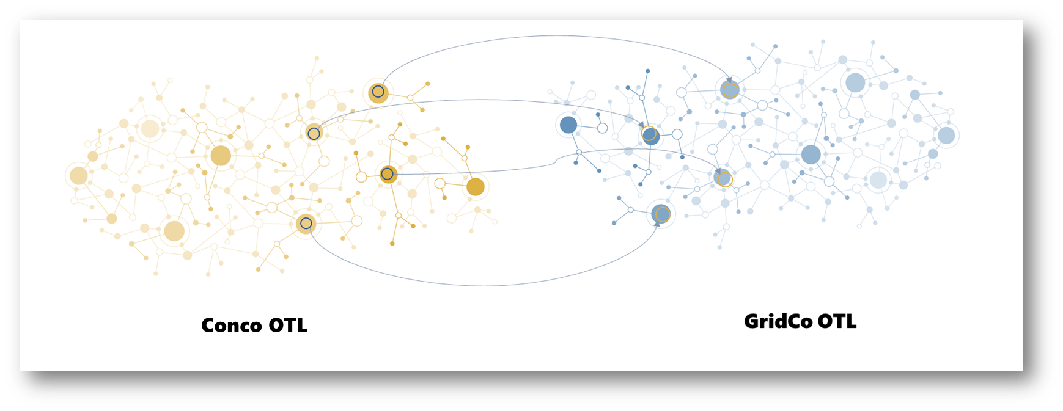
Graph coalescence
Combining graphs
14

Slide 15
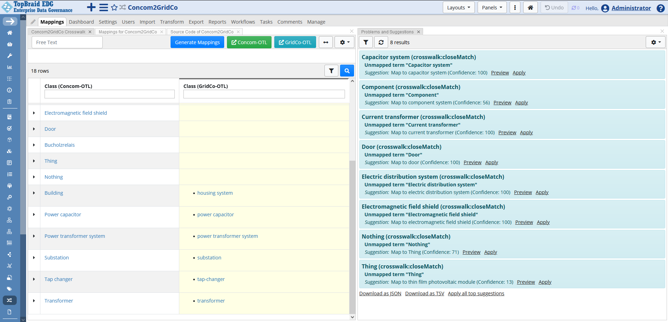
Conco
classes
GridCo
classes
Auto-generated suggestions
15

Slide 16
EXAMPLES:
CB-NL
CFIHOS
MAPPING RULES
HOW MAPPINGS ARE GENERATED
ex:r291029
“door”
Simple similarity of labels
This is used in the demo
Adding more labels
More matches (also false positives)
Third party taxonomies
Transitive closure
conco:Door
gridco:door
Mapping derived by inferencing
16

Slide 17
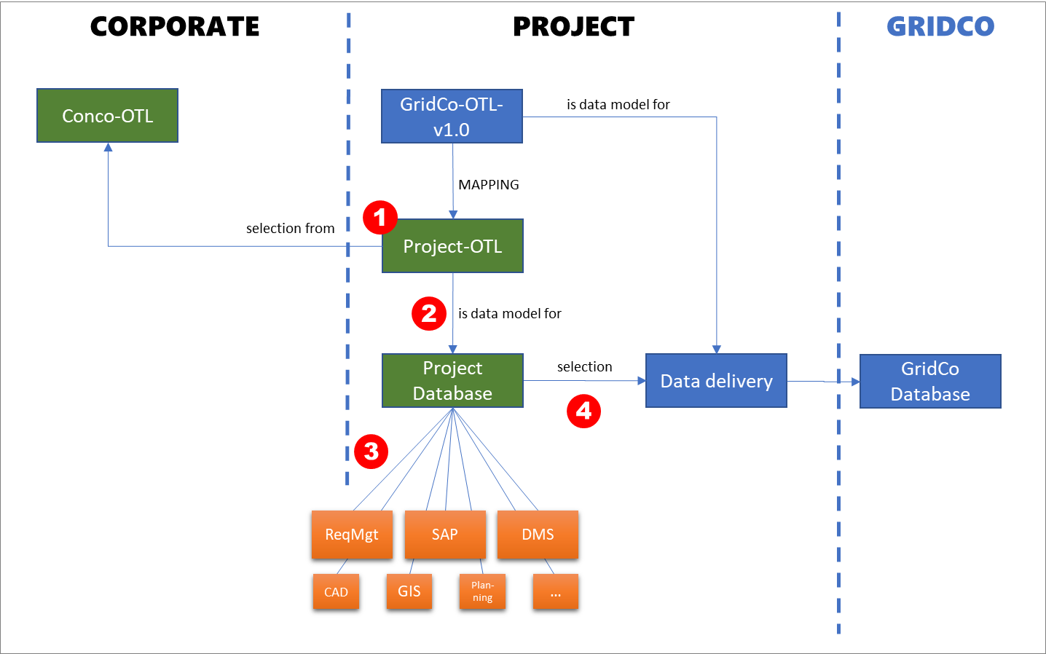
Unified approach
Combining graphs
1
Project OTL
Combining two OTLs and mappings
2
Project database
Conco-OTL is the leading model
3
Integration with back-end IT
Interfaces reusable across projects
4
Data delivery
Reusable SHACL Rules for executing the mapping rules
17

Slide 18
TAKE-AWAYS
Key points
One standardized work process
Based on mappings
Data integration across projects
Knowledge graphs crucially express data and data models in a unified way
21

Slide 19

Eliana
Jan
QUESTIONS?
eliana.papoutsoglou@taxonic.com
jan.voskuil@taxonic.com

